Slide 1
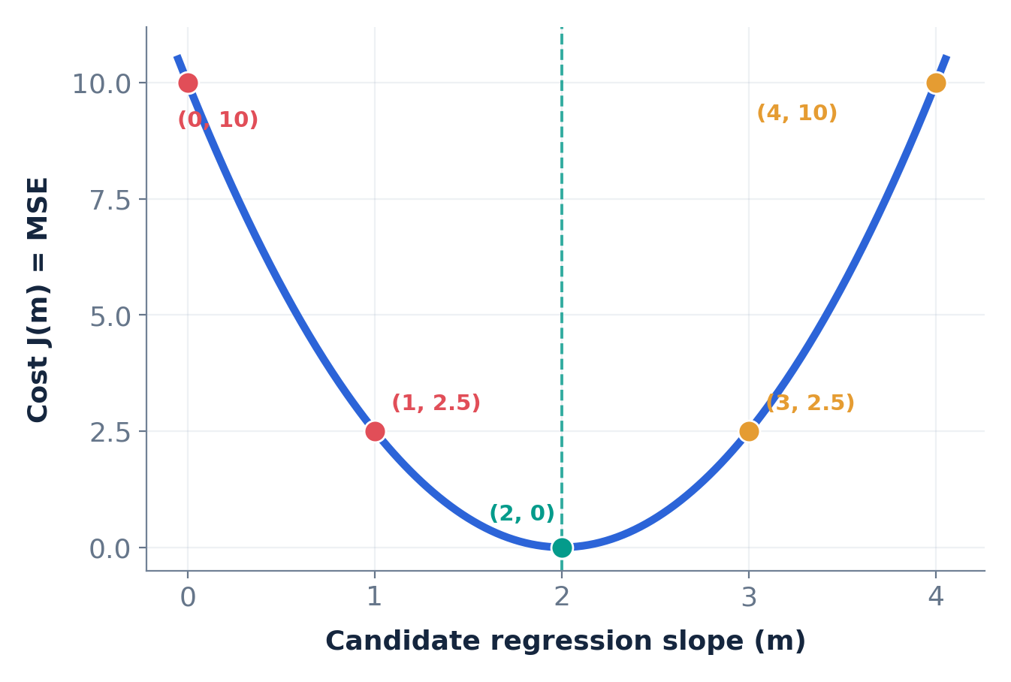
A VISUAL, FULLY WORKED LESSON
Gradient Descent
How does it find the slope?
Two data points → cost curve → negative slope → repeated updates
Our exact example: (1, 2) and (2, 4) | ŷ = mx
Find the minimum error
STEP-BY-STEP • CLASSROOM EDITION
Notes:
Opening script: Today we will not memorize a gradient descent formula first. We will use only two observations, predict their outputs with different slopes, calculate the cost, and see why a negative gradient makes the algorithm increase the regression slope. The intercept is fixed at zero only to keep the arithmetic simple.

Slide 2
GRADIENT DESCENT / CONCEPT / STEP 01
What question are we solving?
We want a line that predicts the data with the smallest possible error.
What we are changing
What tells us the direction?
The regression line’s slope, m.
Different m values produce different predicted marks.
The gradient of the cost curve, dJ/dm.
It shows how the prediction error changes when m changes.
TWO DIFFERENT SLOPES
Regression slope m ≠ Cost-function gradient dJ/dm
SAME WORKED EXAMPLE • X = [1, 2] • Y = [2, 4] • c = 0
02
Notes:
Make students say the distinction aloud: The slope m belongs to the prediction line in the original x-y graph. The gradient dJ/dm belongs to the error graph whose horizontal axis is candidate m and vertical axis is MSE. These can have opposite signs.

Slide 3
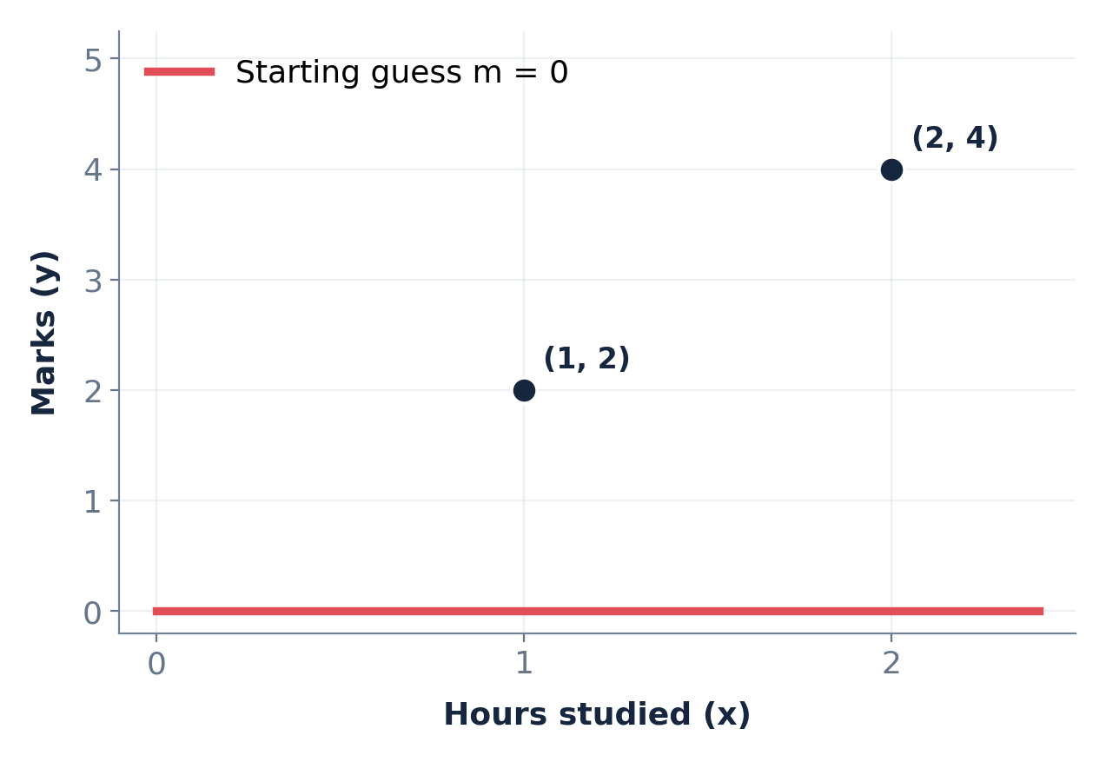
GRADIENT DESCENT / CONCEPT / STEP 02
Our entire dataset: just two points
We fix the intercept at c = 0, so only the slope m needs to be learned.
TRAINING DATA
X (hours)
Y (marks)
1
2
2
4
PREDICTION EQUATION
ŷ = m × x
SAME WORKED EXAMPLE • X = [1, 2] • Y = [2, 4] • c = 0
03
Notes:
Explain x and y, then the model. With c=0, when x=1 the prediction is m and when x=2 the prediction is 2m. Students can see that m=2 is the perfect solution, but we act as though the computer does not know it yet.

Slide 4
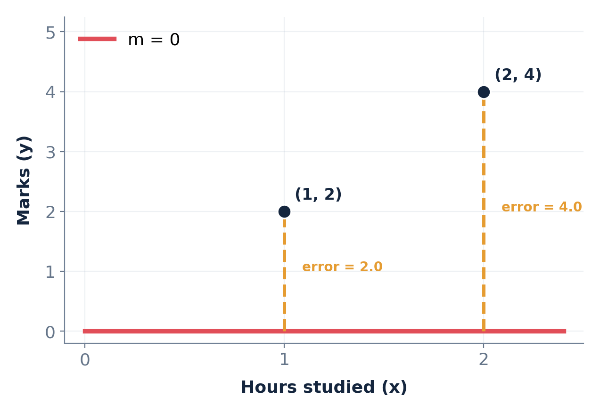
GRADIENT DESCENT / CONCEPT / STEP 03
First guess: m = 0
A flat line predicts zero for both observations.
PREDICTIONS
x = 1 → ŷ = 0 × 1 = 0
x = 2 → ŷ = 0 × 2 = 0
MSE = [(2 − 0)² + (4 − 0)²] / 2
MSE = 10
SAME WORKED EXAMPLE • X = [1, 2] • Y = [2, 4] • c = 0
04
Notes:
At m=0 the line lies on the x-axis. Explain the dashed vertical gaps as residuals. The actual y values are 2 and 4; predicted values are 0 and 0. Squaring gives 4 and 16; average =10. Do not mention derivatives yet.

Slide 5
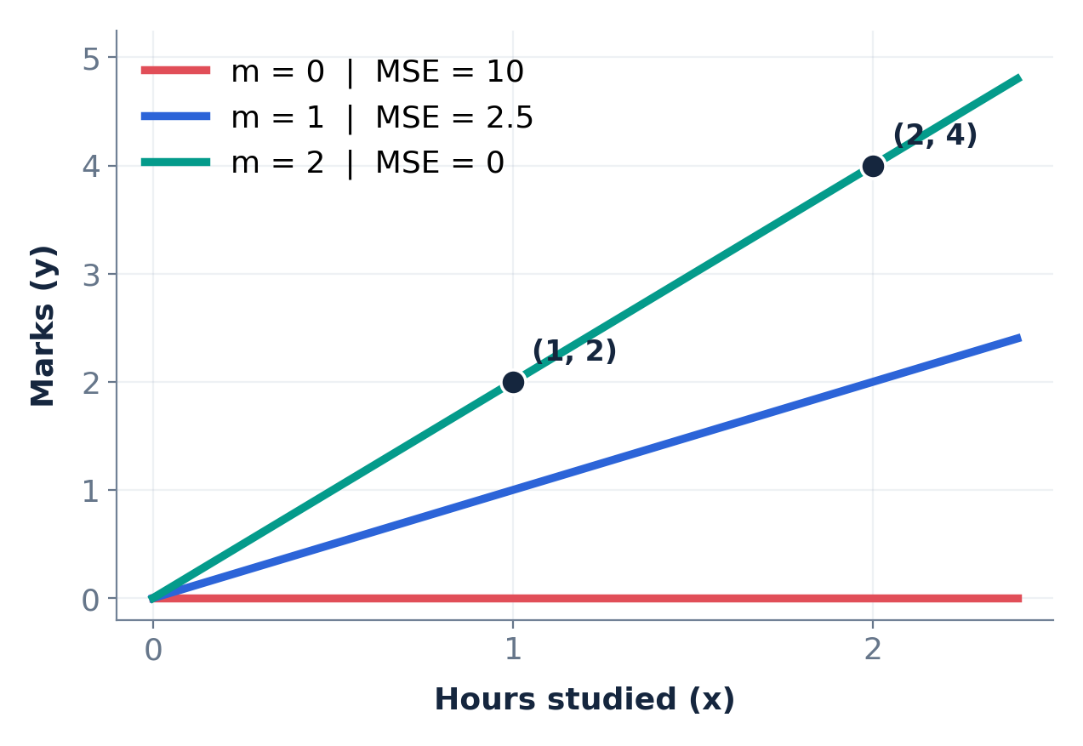
GRADIENT DESCENT / CONCEPT / STEP 04
Try three possible slopes
Changing m changes both predictions and their errors.
COMPARE THE MSE
m = 0
ŷ = 0, 0
10
m = 1
ŷ = 1, 2
2.5
m = 2
ŷ = 2, 4
0
Best of these guesses: m = 2
SAME WORKED EXAMPLE • X = [1, 2] • Y = [2, 4] • c = 0
05
Notes:
Walk through the table. At m=1: predictions 1 and 2; errors 1 and 2; MSE=(1²+2²)/2 =2.5. At m=2 both predictions match, MSE=0. Emphasize cost measures the quality of a chosen slope.

Slide 6
GRADIENT DESCENT / CONCEPT / STEP 05
Build one equation for the cost
Instead of manually testing every m, express the entire error as a function of m.
Observation 1: (1, 2)
Observation 2: (2, 4)
Prediction = m → squared error = (2 − m)²
Prediction = 2m → squared error = (4 − 2m)²
MEAN SQUARED ERROR (2 OBSERVATIONS)
J(m) = [(2 − m)² + (4 − 2m)²] / 2
Simplify: J(m) = 2.5 (m − 2)²
SAME WORKED EXAMPLE • X = [1, 2] • Y = [2, 4] • c = 0
06
Notes:
Algebra: 4−2m = 2(2−m), so (4−2m)^2 = 4(2−m)^2. Sum is 5(2−m)^2; divide by 2 yields 2.5(2−m)^2, equal to 2.5(m−2)^2. J stands for cost. This formula lets us compute error for any candidate slope.

Slide 7
GRADIENT DESCENT / CONCEPT / STEP 06
Turn the formula into a cost curve
Horizontal axis = candidate regression slope m. Vertical axis = MSE.
Left of minimum
Increasing m lowers cost.
At the minimum
m = 2 and J(m) = 0.
Right of minimum
Increasing m raises cost.
SAME WORKED EXAMPLE • X = [1, 2] • Y = [2, 4] • c = 0
07
Notes:
Read points on the curve from left to right: 0→10, 1→2.5, 2→0, 3→2.5, 4→10. The U shape appears because the squared error is quadratic in m. Negative slope on the left refers to this curve, NOT the original regression line.

Slide 8
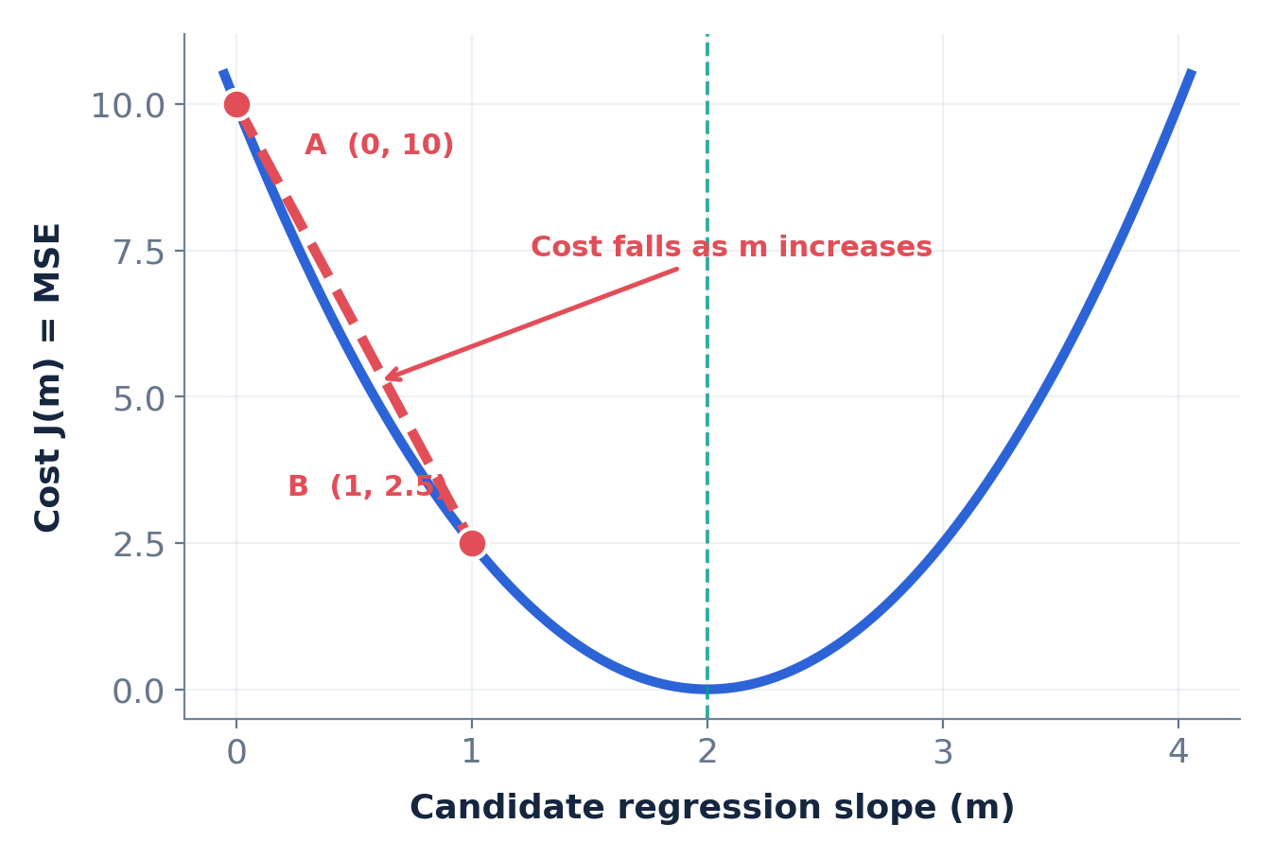
GRADIENT DESCENT / SOLVED EXAMPLE / STEP 07
Calculate the NEGATIVE slope on the left
Take two points on the cost curve—not on the original dataset.
POINTS ON COST CURVE
A = (m = 0, J = 10)
B = (m = 1, J = 2.5)
Slope = Δcost / Δm
= (2.5 − 10) / (1 − 0)
= −7.5
SAME WORKED EXAMPLE • X = [1, 2] • Y = [2, 4] • c = 0
08
Notes:
Read m as the x coordinate and J as the y coordinate. We move right by +1 but down by −7.5. Slope = rise/run = −7.5/+1 = −7.5. This is the average or secant slope between A and B. Ask the class why the numerator is negative.

Slide 9
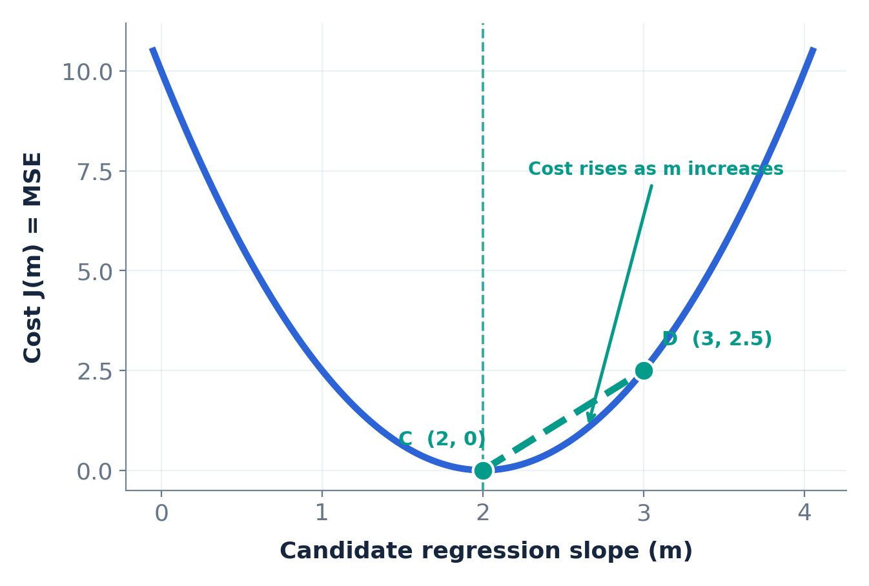
GRADIENT DESCENT / SOLVED EXAMPLE / STEP 08
Calculate the POSITIVE slope on the right
Same calculation—this time the error increases as m increases.
POINTS ON COST CURVE
C = (m = 2, J = 0)
D = (m = 3, J = 2.5)
Slope = Δcost / Δm
= (2.5 − 0) / (3 − 2)
= +2.5
SAME WORKED EXAMPLE • X = [1, 2] • Y = [2, 4] • c = 0
09
Notes:
On the right, movement +1 in m causes +2.5 in J. Slope is +2.5. These are average slopes over an interval. Ask students to contrast right upward with left downward.

Slide 10
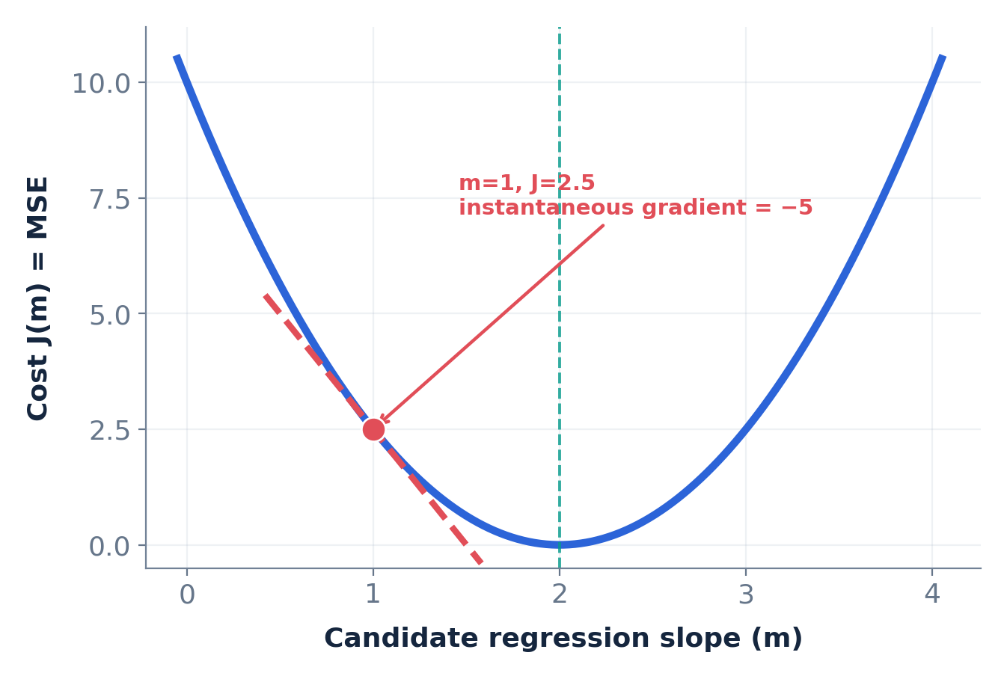
GRADIENT DESCENT / IMPORTANT DISTINCTION / STEP 09
Average slope is NOT the gradient at one point
Gradient descent uses the instantaneous slope of the cost curve.
FIRST: DERIVE THE GRADIENT
J(m) = 2.5(m − 2)²
dJ/dm = 5(m − 2)
AT m = 1
5 × (1 − 2) = −5
Gradient = −5
SAME WORKED EXAMPLE • X = [1, 2] • Y = [2, 4] • c = 0
10
Notes:
The secant slope between m=0 and m=1 was −7.5. The tangent slope precisely at m=1 is −5. Explain that derivative gives the local rate of change. Differentiate J=2.5(m−2)^2 with the chain rule to get 5(m−2). No need to derive general multivariate calculus today.

Slide 11
GRADIENT DESCENT / CONCEPT / STEP 10
The gradient tells us which way to update m
We move against the gradient so that cost decreases.
GRADIENT DESCENT UPDATE RULE
m(new) = m(old) − α × dJ/dm
If gradient is NEGATIVE
If gradient is POSITIVE
Subtracting a negative increases m.
Move RIGHT toward the minimum.
Subtracting a positive decreases m.
Move LEFT toward the minimum.
α = learning rate (step-size multiplier)
SAME WORKED EXAMPLE • X = [1, 2] • Y = [2, 4] • c = 0
11
Notes:
The Greek alpha is learning rate. We will choose 0.1. Gradient descent subtracts the gradient times the learning rate. If the gradient is −5, subtraction makes m increase. If the gradient is +5, subtraction makes m decrease. This describes descent on the error curve.

Slide 12
GRADIENT DESCENT / SOLVED UPDATE / STEP 11
Iteration 1: m moves from 0 to 1
Start at m = 0, learning rate α = 0.1.
1 Gradient at m = 0
dJ/dm = 5(0 − 2) = −10
2 Update the regression slope
m(new) = 0 − 0.1(−10) = 1
Cost falls: J(0) = 10 → J(1) = 2.5
SAME WORKED EXAMPLE • X = [1, 2] • Y = [2, 4] • c = 0
12
Notes:
Compute gradient −10. The update is 0 minus 0.1 times −10, giving m=1. Ask students why subtraction of a negative moves us to the right. Then calculate the cost for the new slope: J(1)=2.5.

Slide 13
GRADIENT DESCENT / SOLVED UPDATE / STEP 12
Iteration 2: m moves from 1 to 1.5
The gradient is still negative, but its magnitude is smaller.
1 Gradient at m = 1
dJ/dm = 5(1 − 2) = −5
2 Update the regression slope
m(new) = 1 − 0.1(−5) = 1.5
Cost falls: J(1) = 2.5 → J(1.5) = 0.625
SAME WORKED EXAMPLE • X = [1, 2] • Y = [2, 4] • c = 0
13
Notes:
Now J gradient at m=1 is −5. New m=1.5. Compute J(1.5)=2.5(−0.5)^2 =0.625. The learning step was 0.5 instead of 1, because the magnitude of the gradient has halved.

Slide 14
GRADIENT DESCENT / SOLVED UPDATE / STEP 13
Iteration 3: m moves from 1.5 to 1.75
We continue downhill; the updates become progressively smaller.
1 Gradient at m = 1.5
dJ/dm = 5(1.5 − 2) = −2.5
2 Update the regression slope
m(new) = 1.5 − 0.1(−2.5) = 1.75
Cost falls: 0.625 → J(1.75) = 0.15625
SAME WORKED EXAMPLE • X = [1, 2] • Y = [2, 4] • c = 0
14
Notes:
Third gradient is −2.5. New m=1.75. J=2.5(−0.25)^2 =0.15625. Explain that proximity to the minimum produces smaller gradients for this quadratic cost function.

Slide 15
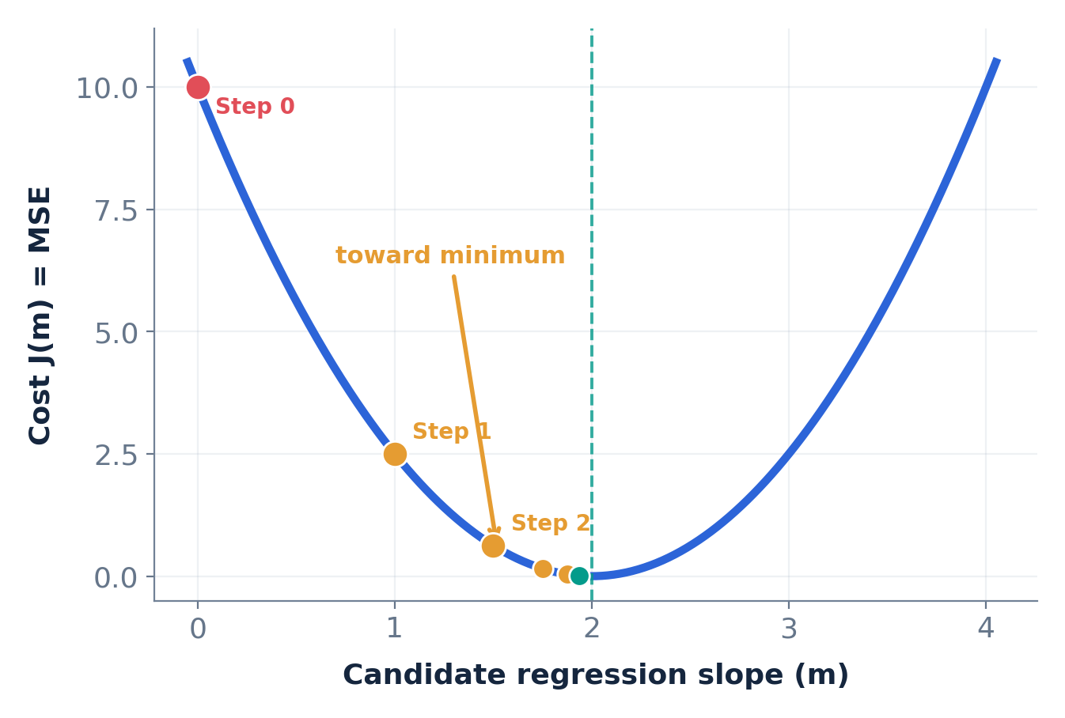
GRADIENT DESCENT / CONCEPT / STEP 14
Watch the slope converge toward 2
Each update reduces the cost, with α = 0.1 in this example.
ITERATION
m
MSE
0
0
10.00000
1
1
2.50000
2
1.5
0.62500
3
1.75
0.15625
4
1.875
0.03906
5
1.9375
0.00977
Limit: m → 2, MSE → 0
SAME WORKED EXAMPLE • X = [1, 2] • Y = [2, 4] • c = 0
15
Notes:
The sequence m=0,1,1.5,1.75,1.875,1.9375,... approaches 2. MSE approaches zero. With α=0.1 here, each update halves the gap 2−m. Distinguish approaching a limit from always hitting it exactly in finitely many steps.

Slide 16
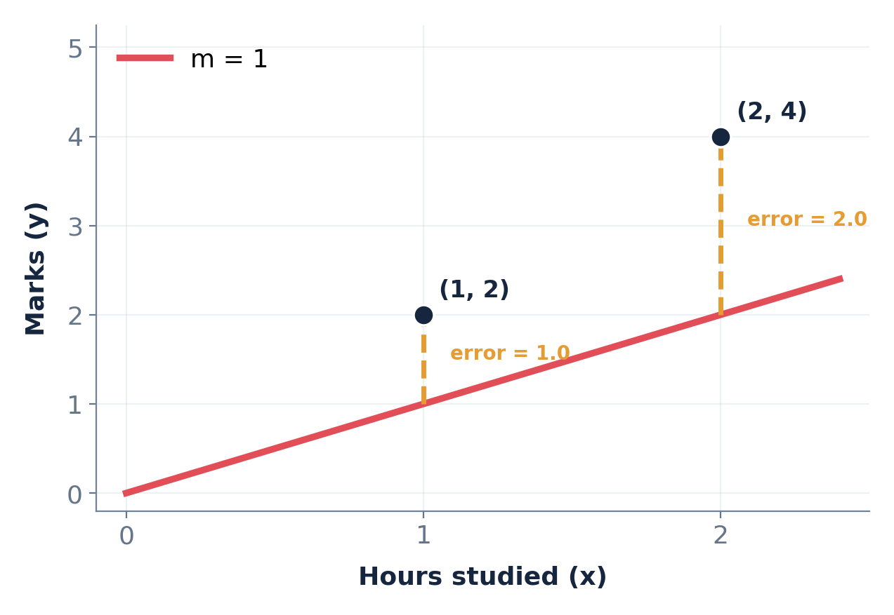
GRADIENT DESCENT / MOST IMPORTANT / STEP 15
Two slopes. Two different graphs.
At the same moment, the regression slope can be positive and cost gradient negative.
REGRESSION LINE
COST CURVE
At m = 1, line slope = +1
At m = 1, gradient = −5
SAME WORKED EXAMPLE • X = [1, 2] • Y = [2, 4] • c = 0
16
Notes:
Stress the axis labels. The regression plot has x (study hours) horizontally and y (marks) vertically. The cost plot has m horizontally and MSE vertically. At m=1 the regression line slopes up (+1), while the cost curve slopes down (−5). These do not contradict each other.

Slide 17
GRADIENT DESCENT / STUDENT CHECK / STEP 16
Your turn: what if we start on the RIGHT side?
Use the exact same equation and learning rate.
Given:
Current m = 3 | α = 0.1
Gradient rule: dJ/dm = 5(m − 2)
1. Is the gradient positive or negative?
2. What is the new value of m?
PAUSE FOR STUDENT ANSWERS
SAME WORKED EXAMPLE • X = [1, 2] • Y = [2, 4] • c = 0
17
Notes:
Give students 60–90 seconds. They should evaluate gradient=5(3−2)=+5, then update m_new=3−0.1×5 =2.5. Ask them to describe the move as LEFT on the cost curve. Do not display next slide until they answer.

Slide 18
GRADIENT DESCENT / STUDENT CHECK / STEP 17
Answer: positive gradient means move LEFT
At m = 3 the cost rises as m increases, so gradient descent decreases m.
1 Gradient = 5(3 − 2) = +5
2 m(new) = 3 − 0.1(+5) = 2.5
3 Cost: J(3) = 2.5 → J(2.5) = 0.625
The slope m moves toward 2 from BOTH sides of the curve.
SAME WORKED EXAMPLE • X = [1, 2] • Y = [2, 4] • c = 0
18
Notes:
Work through the positive gradient case. Moving m from 3 to 2.5 reduces cost from 2.5 to .625. The negative sign before learning rate gives descent on both sides.

Slide 19
GRADIENT DESCENT / CODING DEMO / STEP 18
Optional Python demonstration
Every line of code corresponds to one step we calculated by hand.
import numpy as np
X = np.array([1, 2])
y = np.array([2, 4])
m = 0.0
alpha = 0.1
for i in range(6):
y_pred = m * X
mse = np.mean((y - y_pred)**2)
gradient = 2*np.mean(X*(y_pred-y))
print(i, round(m, 4), round(mse, 4))
m = m - alpha * gradient
predict
ŷ = m × X
measure error
MSE = mean[(y − ŷ)²]
update m
m = m − α × gradient
Print happens before the update.
SAME WORKED EXAMPLE • X = [1, 2] • Y = [2, 4] • c = 0
19
Notes:
Execute the loop in a notebook. Show students where the prediction, MSE, gradient, and update each occur. The gradient formula 2*mean[X*(pred−y)] is the derivative of MSE for the zero-intercept model. The print statement displays each iterate before it is updated.

Slide 20
GRADIENT DESCENT / SUMMARY / STEP 19
What students should remember
One example. One cost curve. One repeatable process.
1
Choose a starting slope
Try m = 0.
2
Calculate predictions and error
J(0) = 10.
3
Calculate the COST gradient
At m = 0, dJ/dm = −10.
4
Move opposite to the gradient
m(new) = 0 − 0.1(−10) = 1.
5
Repeat until the error is low
m moves toward 2; MSE toward 0.
Negative COST gradient ≠ negative regression slope.
SAME WORKED EXAMPLE • X = [1, 2] • Y = [2, 4] • c = 0
20
Notes:
Close by asking students to describe in their own words why a cost gradient of −5 tells us to increase m. Revisit difference between a secant slope (−7.5) and a derivative at m=1 (−5). Highlight that the intercept was fixed at 0 for this demonstration; in general the intercept is updated too.

